Slide 1
Remediation
Next Step in an Effective Program
Pierce Crowell
Social Security Administration
Notes:
Captain obvious
If you want something done right...?
If you want someone to do something...?

Slide 2
SSA Section 508 Program
Inclusive culture
Executive sponsorship
Lifecycle processes require testing
Embed 508 SMEs in high priority projects
Teams regularly seek design, development, and policy advice
Everything is tracked and we can see trends in our metrics
Introduction
Notes:
Our mission and composition make 508 much easier

Slide 3
Emphasis on the “Fixing Side” of Our Program
Long legacy of seeking solutions
ASB = Accessible Solutions Branch
How to eat an elephant
One fix at a time
Increasing our technical capabilities
Code inspection since 2014
Remediation competency since 2017
Two years of recorded data
Notes:
SSA started their 508 program in 1995, and even though there was not much that could be done, we’ve always been fixing things for PWDs

Slide 4
What Are Remediation Instructions
Simple ‘how to’ instructions
Plain language
Tangentially instructive

Slide 5
Hypothesis: Remediation Instructions Are More Potent
Decision to accept new work is complex
Humans rely on feeling more than rationale when making decisions
What rewards are your Fixers getting...?
Self-rewards
Desire to repeat good experiences / avoid bad experiences
Changes perspective
Fixing defects is quantifiably measurable
Accept the challenge, collect metrics, and decide for yourself

Slide 6
Read the Room
You’re the one who wants something
Decision making is complex and brittle
Likely only days left before “go live”
Project team is in “gonzo” mode
The default answer is “No new work this release”
Accessibility experts most qualified
What makes us think teams want to
Research, experiment, unit test, and repeat until it’s fixed
Take on the risk of changing code (with nothing to consider)
Trust people who don’t know the context and can’t write instructions

Slide 7
The Remediation Promise
No Fix...?
No Defect...!

Slide 8
Poor Instruction Categories
Echo Chamber
Associate the label with the text field
AT centric
Ensure a screen reader says “Street”
Vague/confusing
Add a matching for attribute
Off topic or Soap Box
Multiple issues in one defect
Use HTML semantics over aria...
Best Practices
See XYZ for instructions on how to fix this type of defect
Tutor
Always associate text fields with their respective input tag through a for/id match, unless the label text is not sufficient and in which case use an aria-label, aria-labelledby, title attribute, or other attributes that support a good user experience

Slide 9
What Low/No Remediation Feels Like
I need to understand what I’m agreeing to...
Will it break other things
How long will troubleshooting go on
Risks these changes can introduce
Can’t estimate the time if we don’t...
Know the difficulty
Skill level needed to fix
I’m not confident...
In you, my platform, 508 people, my team’s skills, etc.

Slide 10
The Formula: Remediation Instructions
Tie back to the issue (optional)
Instructions (add/remove/edit)

Slide 11
The Formula: Remediation Instructions
Consistent terms
Tag (element), attribute, value, associate, etc.
Use <tag> marks
[attribute brackets]
“values in quotes”
Show the resulting HTML (to be code)
Just enough
Instruct, but don’t teach
Validate your instructions
No options (Highlander Rule)

Slide 12
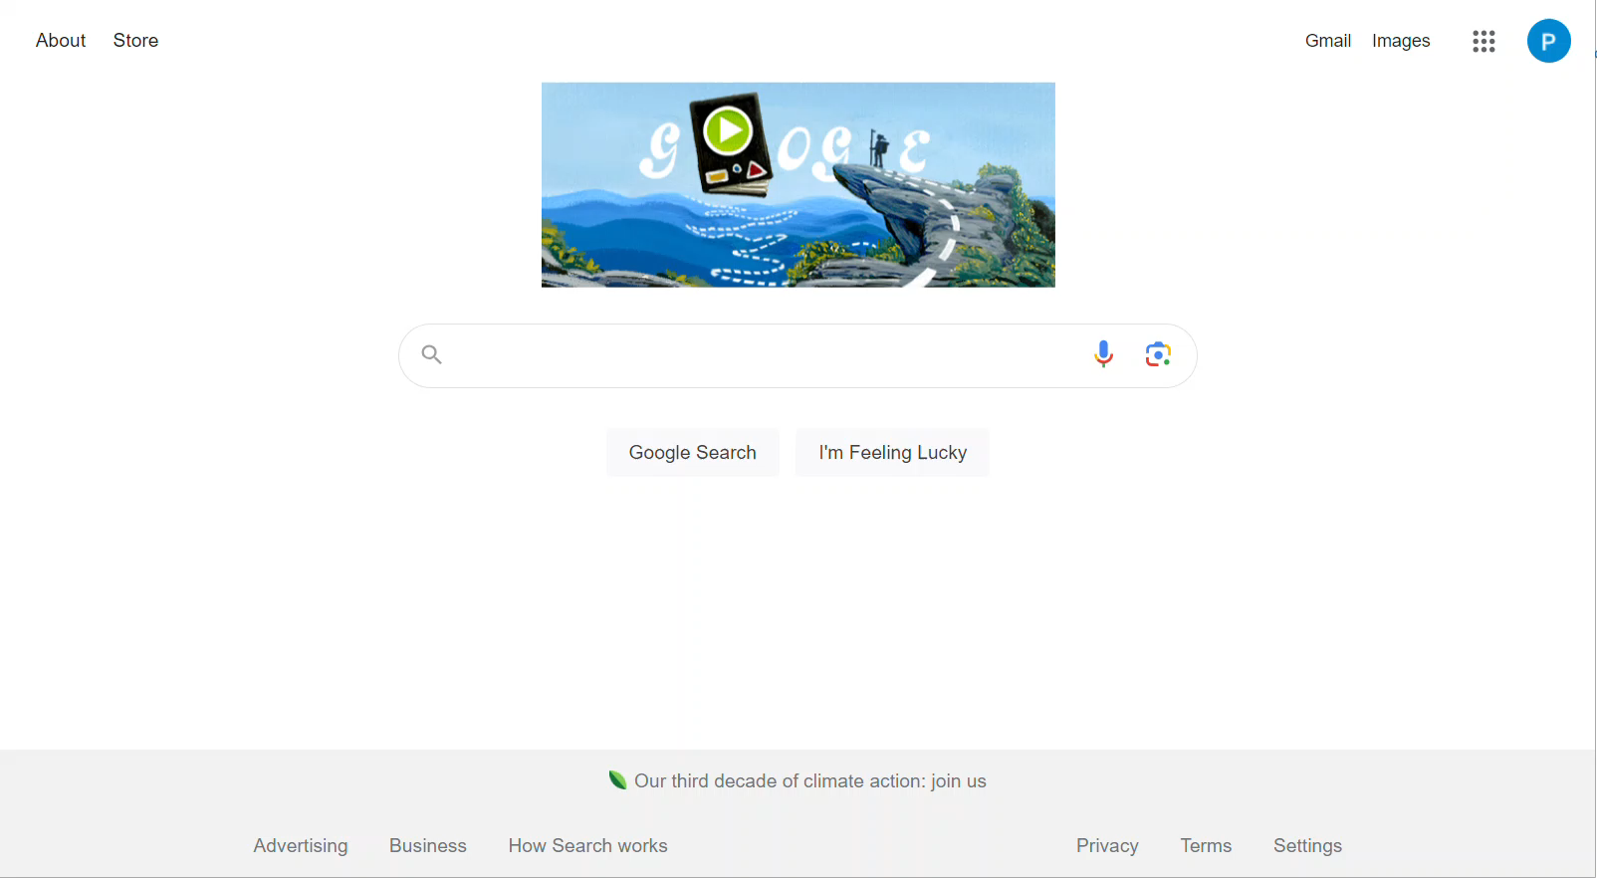
ANDI Demo Page Video

Slide 13
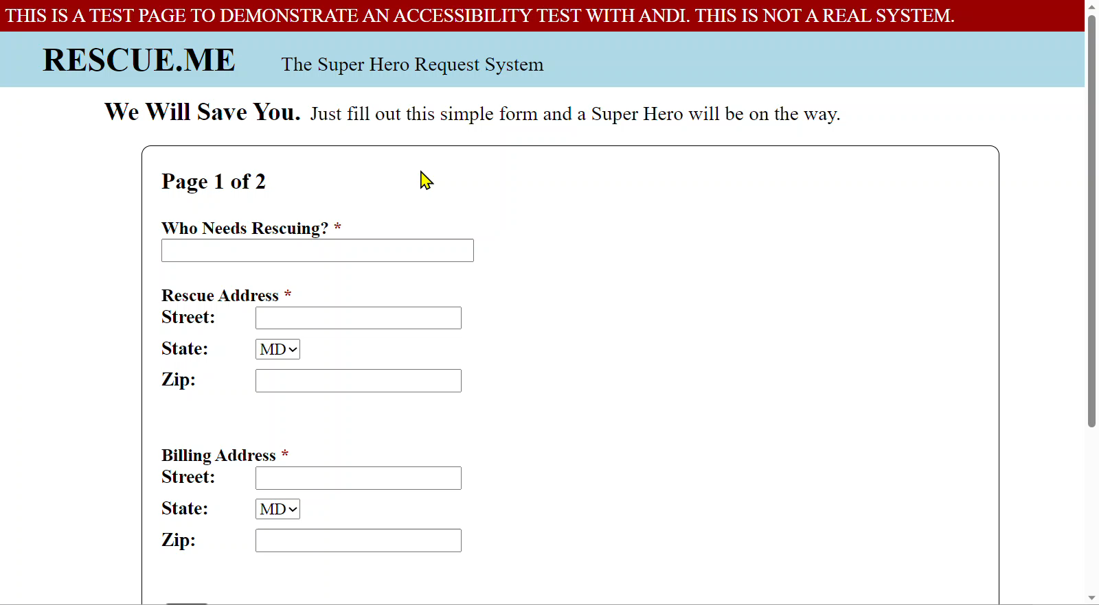
Street Address Fix Video One

Slide 14
Text Element with No Accessible Name
Pass Condition:
All instructions and cues are related to their respective input components.
Defect Description:
The Street address text field has no accessible name or description. People who are blind and some users with low vision will have difficulty navigating to and using this text field.

Slide 15
Anatomy of Remediation Instructions
Tie back to the issue (optional)
To associate the <label> text with its <input> element...
Instructions (add)
[for=“ra-street”]
...to the <label> tag

Slide 16
Text Element with No Accessible Name
Pass Condition:
All instructions and cues are related to their respective input components.
Defect Description:
The Street address text field has no accessible name or description. People who are blind and some users with low vision will have difficulty navigating to and using this text field.
Remediation:
To associate the <label> text with its <input> element, add [for=“ra-street”] to the <label> tag.

Slide 17
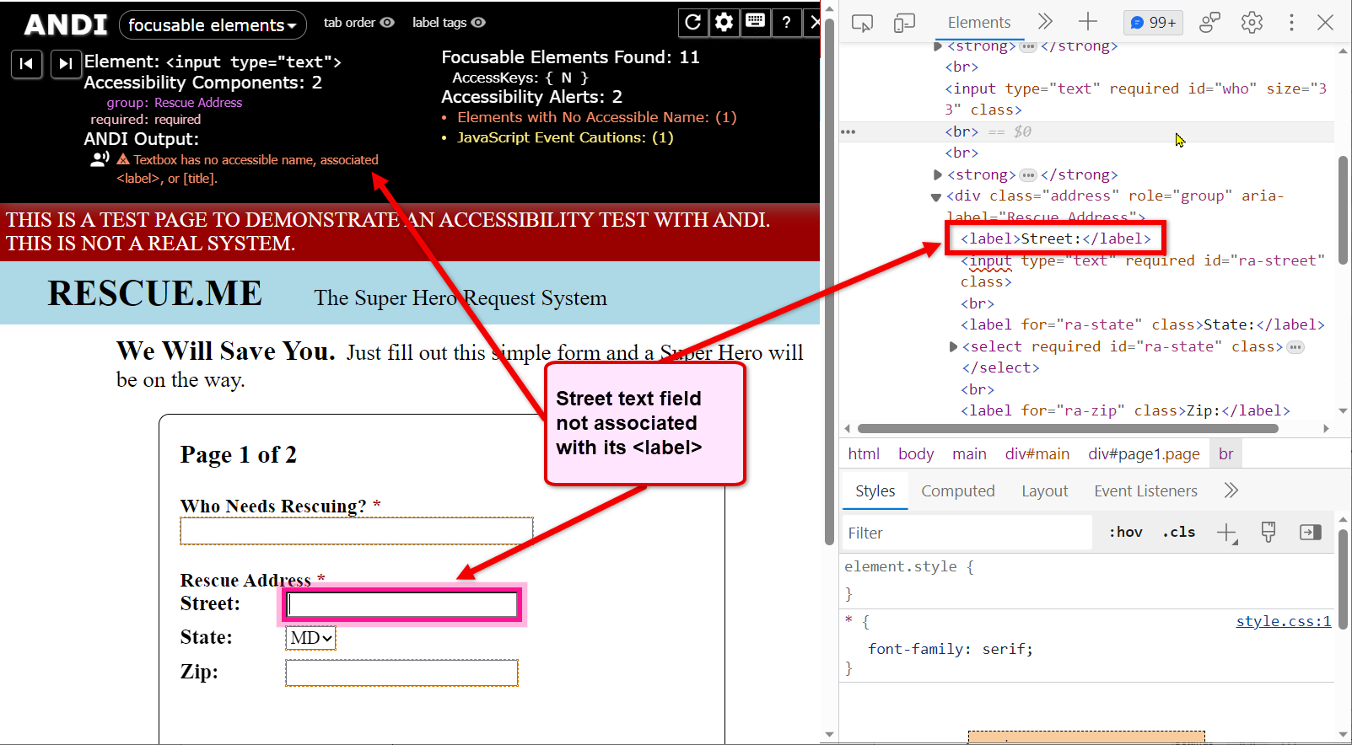
Text Element with No Accessible Name

Slide 18
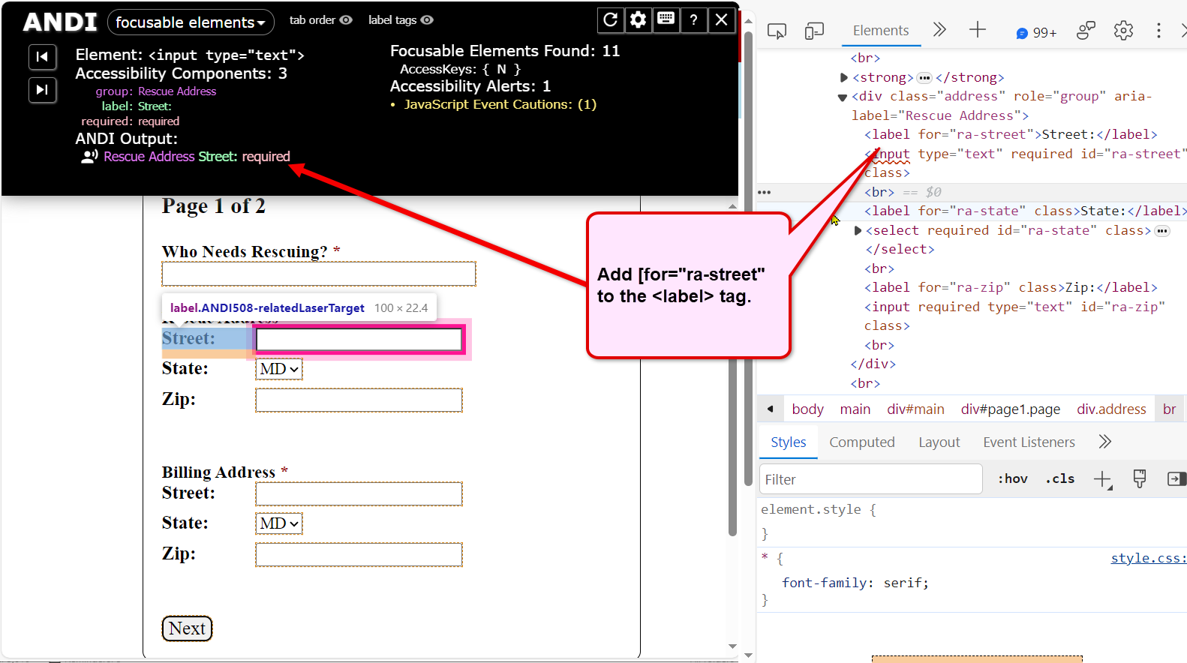
Text Element with No Accessible Name

Slide 19
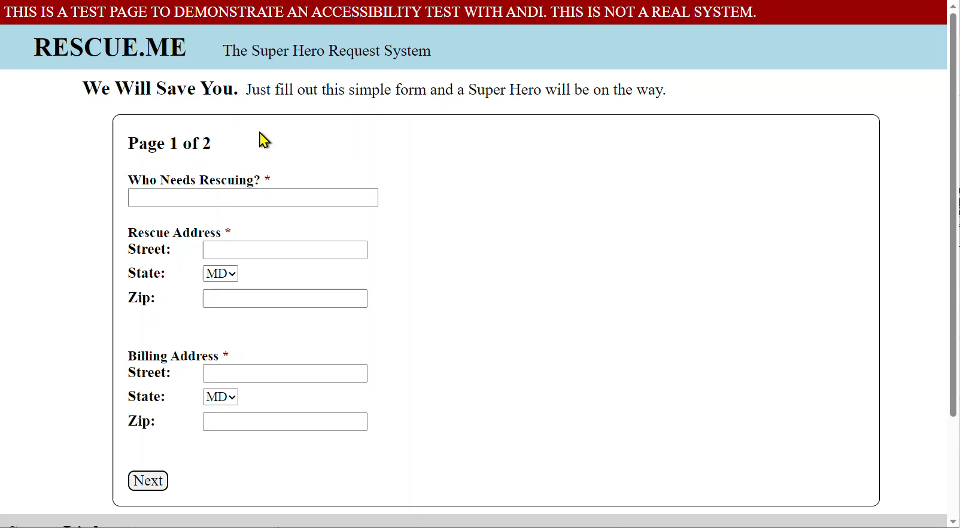
Billing Address Fix Video One

Slide 20
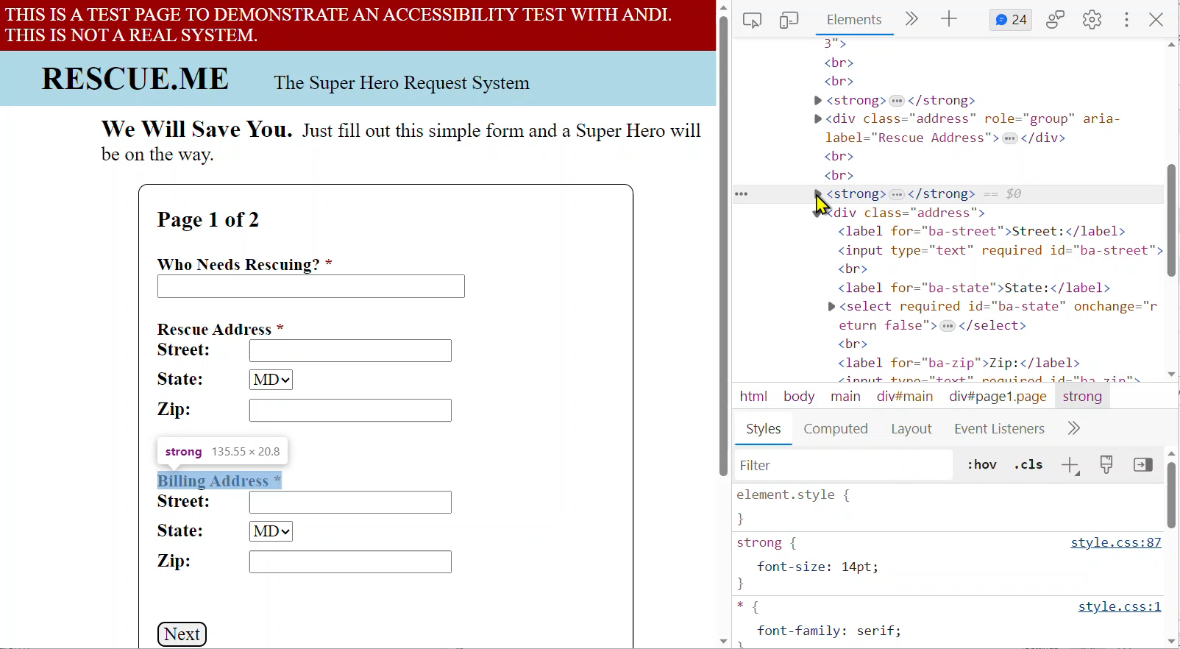
Billing Address Fix Video Two

Slide 21
Grouping Not Identified and With No Accessible Name
Pass Condition:
All instructions and cues are related to their respective input components.
Defect Description:
The text “Billing Address” should be associated with the three elements below. Without this association, screen reader users will have difficulty entering the correct data.

Slide 22
Anatomy of Remediation Instructions Grouping Forms
To associate “Billing Address” with its group of form elements...
Add...
[role=“group”]; and
[aria-label=“Billing Address”]
...to the <div> that contains the form elements
To associate “Billing Address” with its group of form elements, add [role=“group”] and [aria-label=“Billing Address”] to the <div> that contains the form elements.

Slide 23
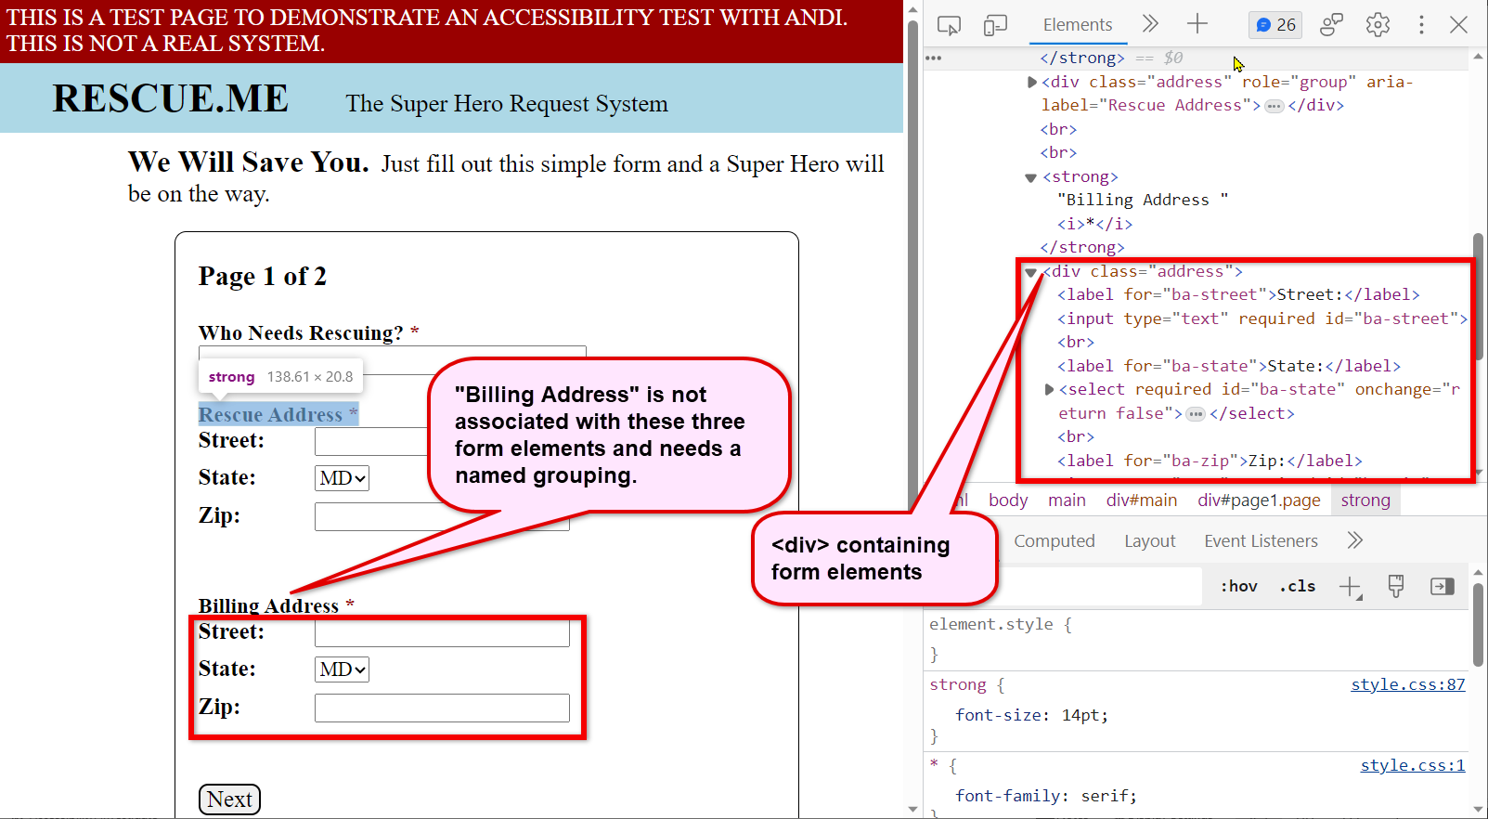
Grouping Not Identified and With No Accessible Name

Slide 24
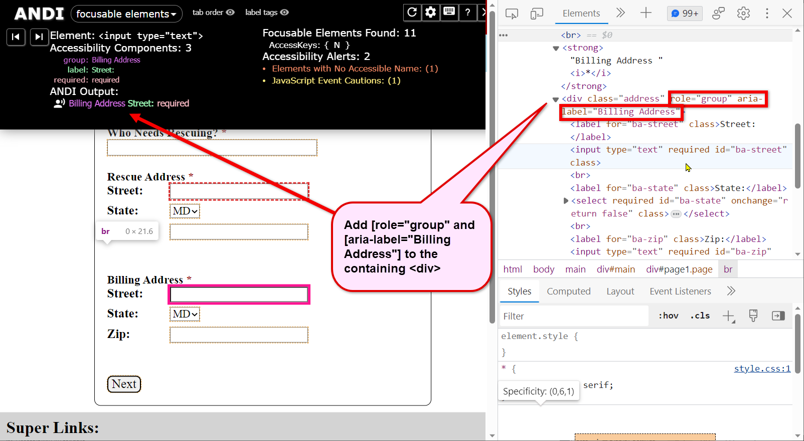
Grouping Not Identified and With No Accessible Name

Slide 25
Picking the Solution
If you’re not certain of the fix
Get more code, project, and platform context
Collaborate (bring in platform experts, vendors, other SMEs)
Once you commit yourself, it’s not hard
If you don’t pick the solution
Less valuable because fewer things get fixed
Doubt: “So, you don’t know which one I should use?”
They may pick the bad option

Slide 26
How to Hook A Developer
The fix works in their code
Nothing but simple instructions to read
No teaching, no preaching, just fixing
Do not impede their curiosity
“So, I wonder...”
How does this fix work?
How’d they know the fix would work?
Can I use this fix in similar places?
Notes:
Remediation is like a sport...similar to fishing.

Slide 27
* Scripting Is Different
Scripting instructions are described
Too risky, too technical, too difficult
Use the Best Practices model
Reputable sources
Start local and work your way outward
ARIA Practices Guide (APG)
Know your details about the examples (variables, behaviors, etc.)
Briefly describe the functions/behavior
Cite the specific example
Select the correct options/variations

Slide 28
What You Can Expect from Remediation Success
More things getting fixed
Eliminate legal arguments by up to 99%
Teams willing/able to make last minute fixes
Aligning with developers so they commit
Building development/testing skills
Learning about accessibility and helping their peers
Implied trust
Fewer initial defects...!
Queue the squiggly lines...

Slide 29
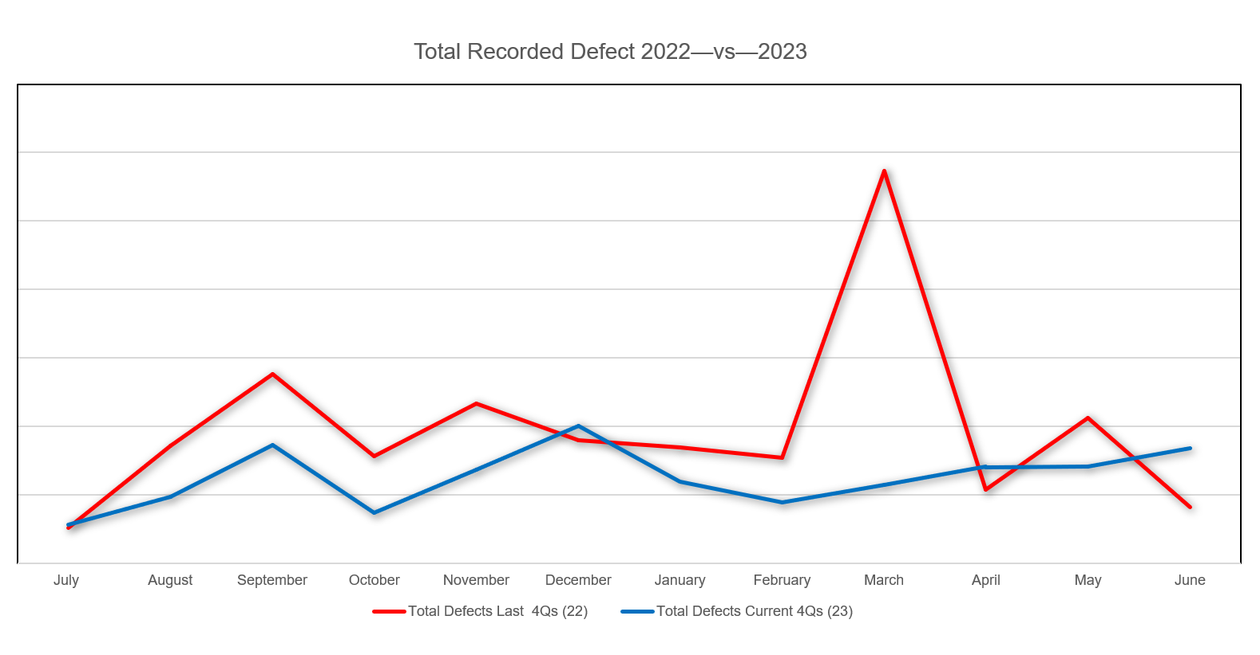
Fewer Defects Recorded

Slide 30
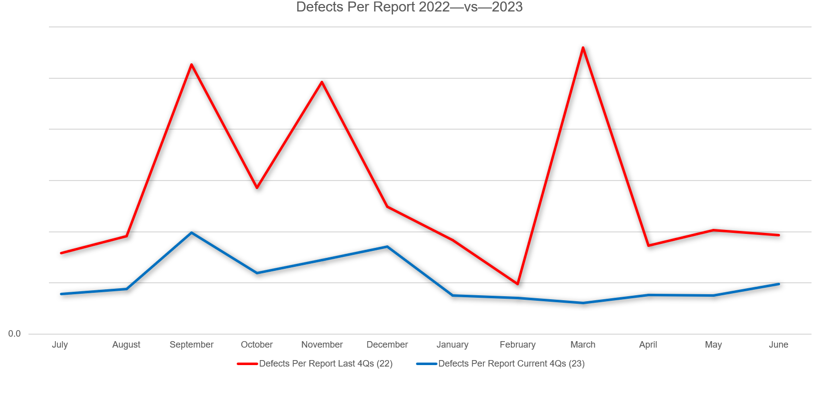
Fewer Defects Per Test Report

Slide 31
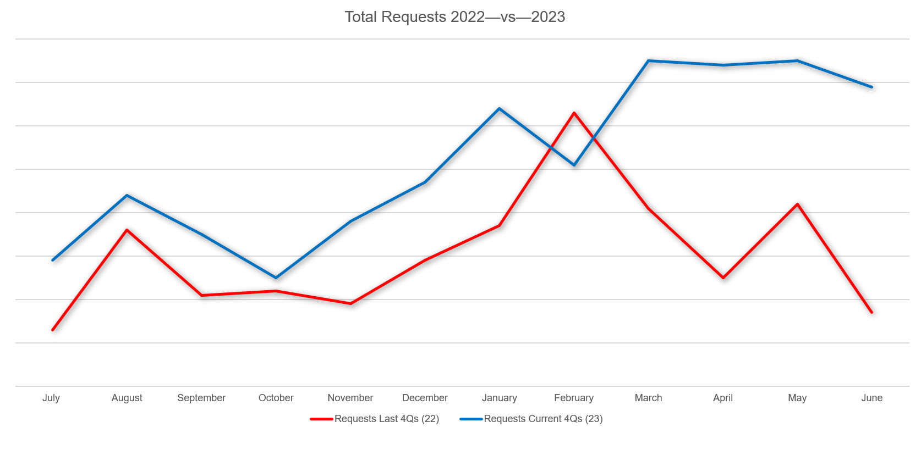
More Test Requests...!

